Slide 1

This is your year:
Get Certified in 2023

Slide 2
ABOUT US
The ATD Certification Institute (ATD CI) is a separate, non-profit organization under the umbrella of ATD National.
Our mission of is to lead and elevate the talent development profession and to recognize practitioners for their knowledge and application through certification.
We accomplish this by setting standards, assessing competence against those standards, closing skills gaps, and recognizing achievement.

Slide 3
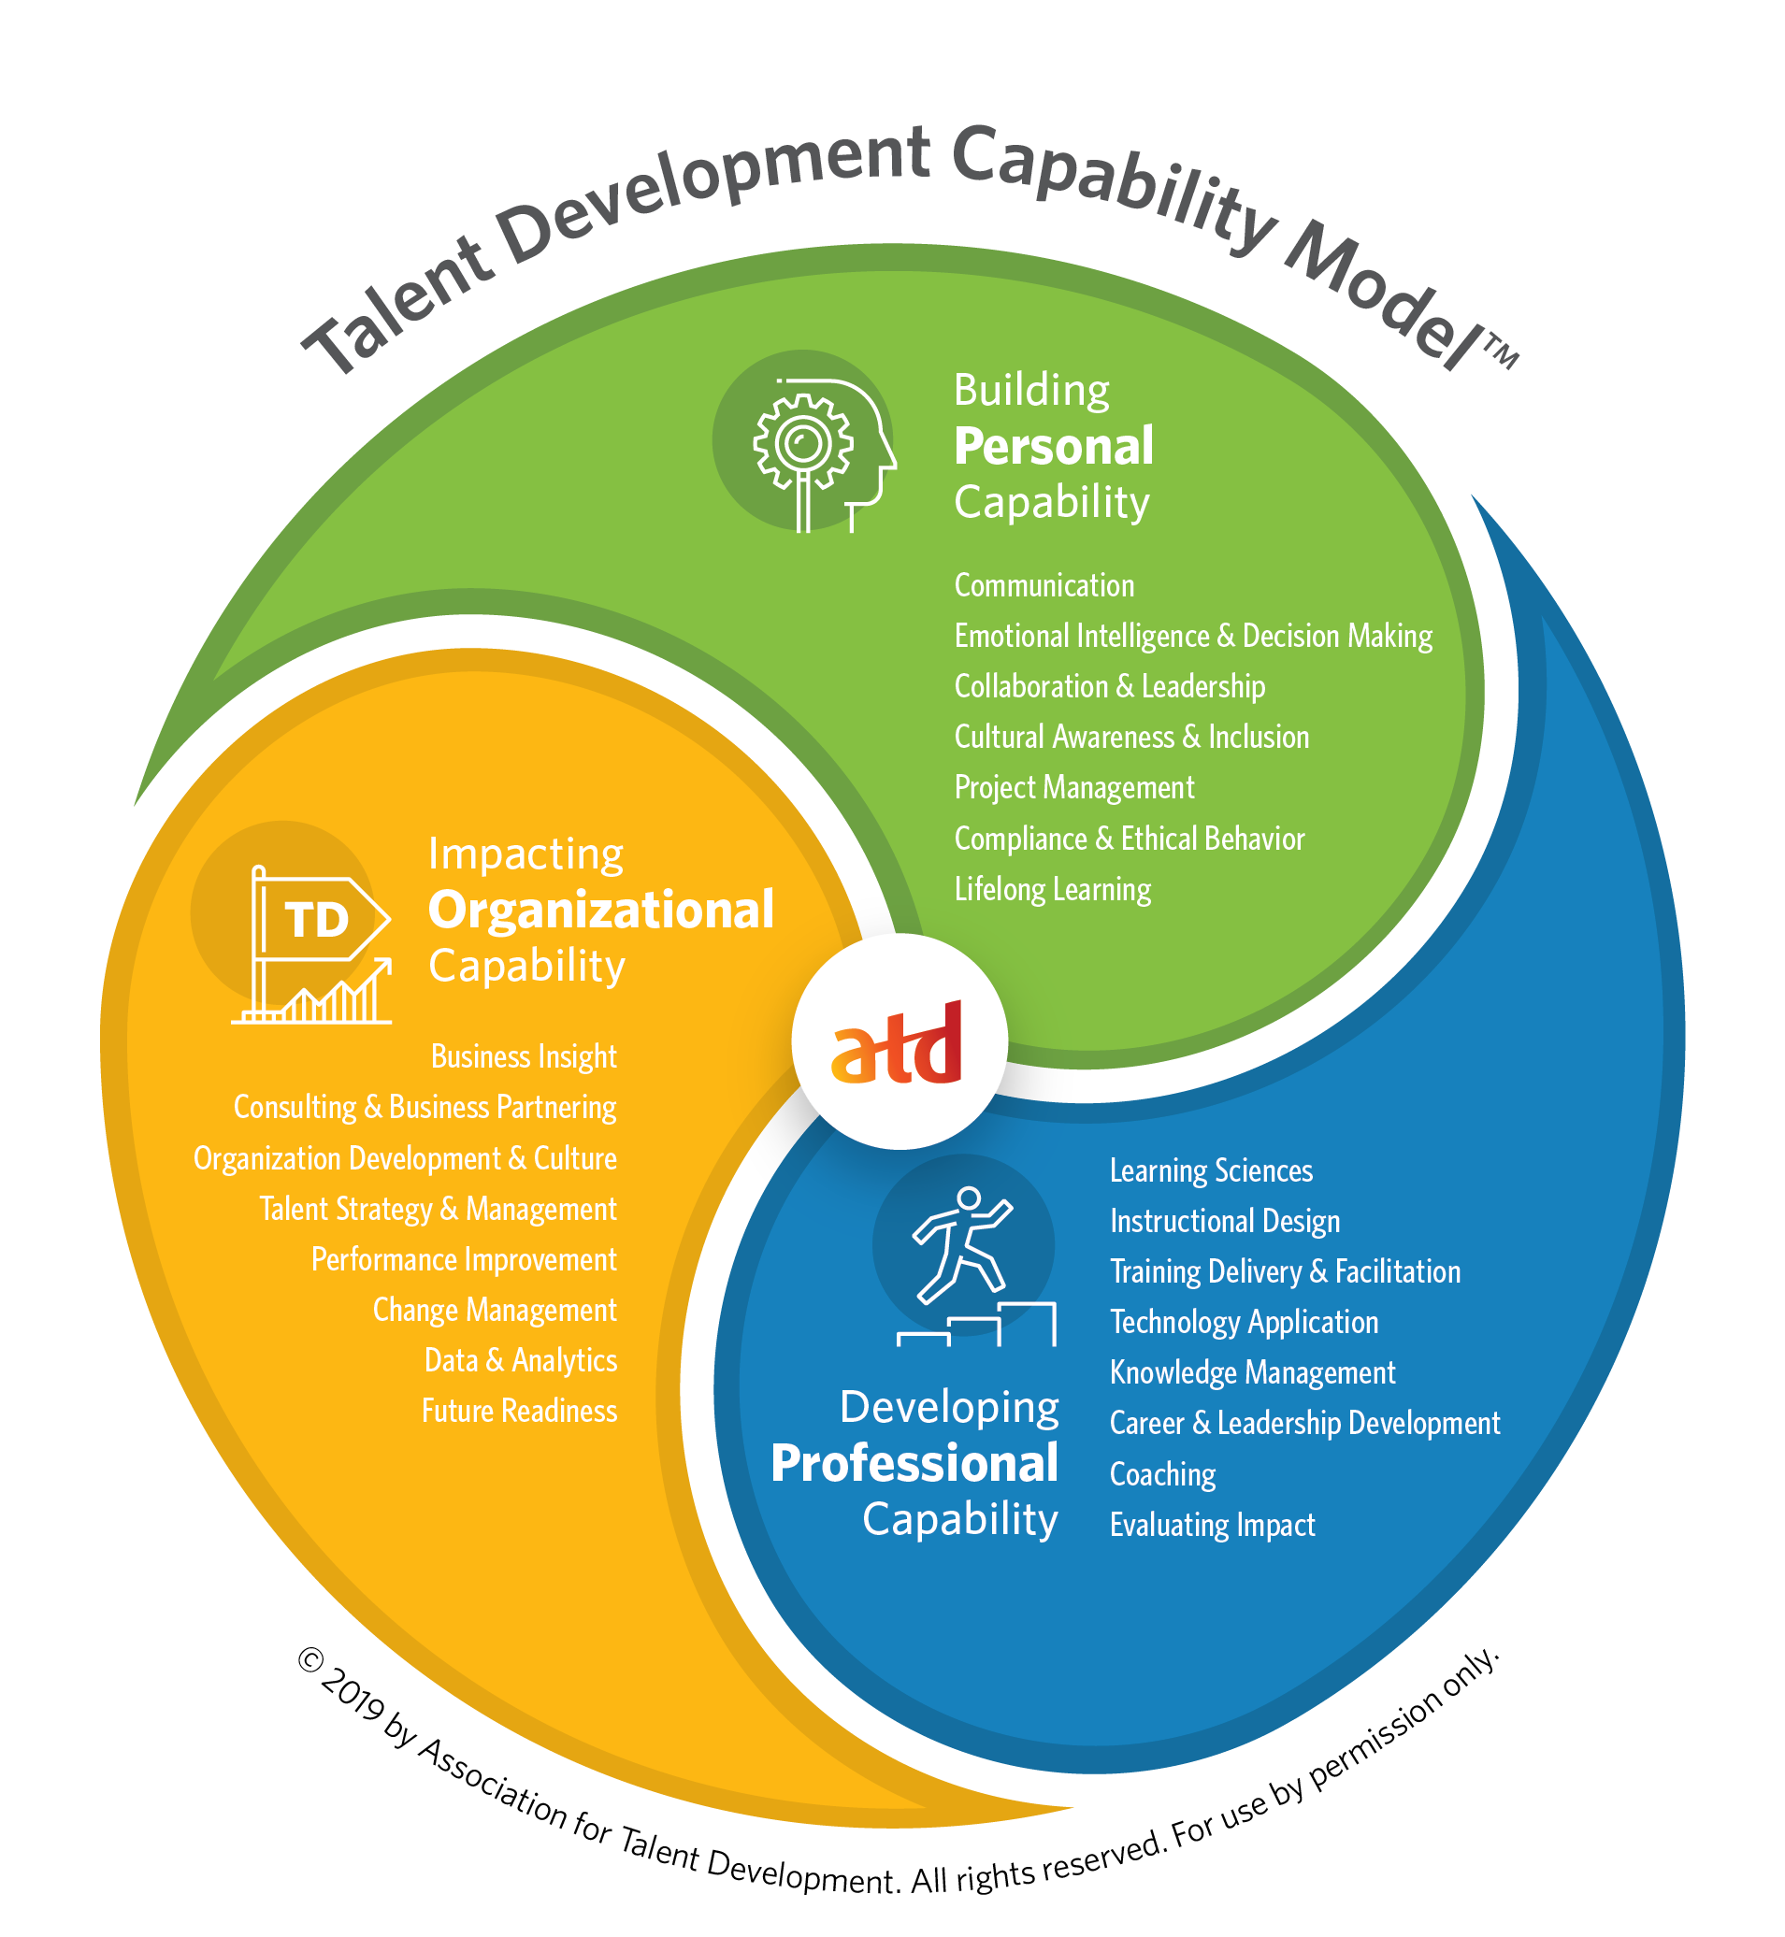
The standards for the profession are based on the Talent Development Capability Model, which answers the question: what do talent development professionals need to know and do to be successful in the field, today and in the future?

Slide 4


There are two certifications offered by the ATD Certification Institute.
Associate Professional in Talent Development | Certified Professional in Talent Development
3 years of Work Experience | 5 years of Work Experience
28 hours of professional development | 60 hours of professional development
For early-career professionals or those whose job has a narrow focus or not a full-time role | For more senior-level talent development professionals seeking a leadership role

Slide 5
AGENDA
Why this is your year
Choosing the right window
Eligibility in a nutshell
Preparing for the exam
Application basics
How to get support
Questions

Slide 6
2023 is your year
Opportunity AWAITS
A TRUSTED Program
As of this week, there are 204 US job announcements in the on LinkedIn requesting or requiring the APTD or CPTD. It’s your chance to stand out.
92.6% of APTDs and CPTDs say they gained new insights about talent development by becoming certified. It’s a solid program trusted by TD professionals like you.
New year; new you
Although certificants receive 18 months of eligibility, registering now and planning a good preparation timeline can warrant an earned certification this year. Make it your 2023 goal.

Slide 7

2023 ACTION PLAN
Preparing for the APTD can be as little as 3 months
run focus group
Gather feedback
May 20XX
Oct 20XX
2023
JAN
FEB
MAR
APR
MAY
JUN
JUL
AUG
SEP
OCT
NOV
DEC
Commit to earning certification in 2023; make a plan
Preparing for the CPTD can be as little as 6 months
Launch design
Deliver to client
July 20XX
Dec 20XX

Slide 8
2023 ACTION PLAN
But spreading preparation out to 6-7 months still allows plenty of time to APTD-certify in 2023
run focus group
Gather feedback
May 20XX
Oct 20XX
2023
JAN
FEB
MAR
APR
MAY
JUN
JUL
AUG
SEP
OCT
NOV
DEC
Commit to earning certification in 2023; make a plan
Same for the CPTD
Launch design
Deliver to client
July 20XX
Dec 20XX

Slide 9
2023 ACTION PLAN
APTD is given in odd-numbered months.
CPTD is given in even-numbered months.
But spreading preparation out to 6-7 months still allows plenty of time to APTD-certify in 2023
run focus group
Gather feedback
May 20XX
Oct 20XX
2023
JAN
FEB
MAR
APR
MAY
JUN
JUL
AUG
SEP
OCT
NOV
DEC
Commit to earning certification in 2023; make a plan
Same for the CPTD
Launch design
Deliver to client
July 20XX
Dec 20XX

Slide 10
Eligibility Requirements

Slide 11
Eligibility Requirements
3 years
(36 months)
28 hours
Professional Development/
education
Work Experience
Details
Details
Does not have to be previous 3 years
Role must have included tasks from Professional and Organization domains of TD Capability Model
Full-time or Part-time
Completed within last 3 years
PD must be complete at time of application
Content of PD must be from Professional and Organization domains of TD Capability Model
Trackable/reportable in case of audit

Slide 12
Eligibility Requirements
5 years
(60 months)
60 hours
Professional Development/
education
Work Experience
Details
Details
Does not have to be previous 5 years
Role must have included tasks from Professional and Organization domains of TD Capability Model
Full-time or Part-time
Completed within last 5 years
PD must be complete at time of application
Content of PD must be from Professional and Organization domains of TD Capability Model
Trackable/reportable in case of audit

Slide 13






A little more about eligibility…
Professional development takes all kinds of forms.
You may already have what it takes to be eligible.
Email certification@td.org to request help in determining eligibility.

Slide 14




BUSINESS MODEL
Eligibility isn’t just about checking a box though
Good eligibility components actually will prepare you for the exams.
And everyone must meet the standard to test, which further elevates the credential for the profession.
RESEARCH
ABSTRACT
DESIGN
We based our research on market trends and social media
We believe people need more products specifically dedicated to this niche market
Minimalist and easy to use

Slide 15
Application Basics

Slide 16
Application basics
The applications can be found in the Certification Portal.
Details About your Professional Development
Details About your Work
A recent resume
Current employer information, contact information for your supervisor, and capabilities covered in your role.
Type of activity, sponsor, start and end date, number of hours, and capabilities covered.
PDF or .doc file
Your desired testing window
Extras*
*Not necessarily needed by everyone
ADA information
ATD Master Certificate PDF
2-month window
Remember– every other month!

Slide 17
Registration Fees
Payable in full at the time of application
$499/699
APTD Registration Fee (ATD National Member/non-member)
$975/1350
CPTD Registration Fee (ATD National Member/non-member)
$various
See the APTD or CPTD Certification Handbooks for other fees that may be incurred.

Slide 18
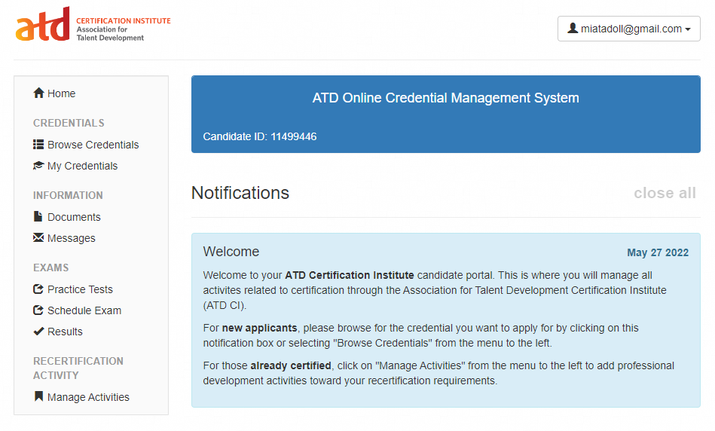
The Application
email@email.com

Slide 19
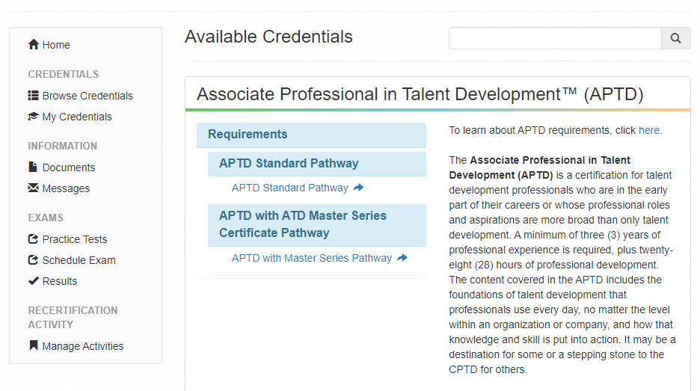
The Application
email@email.com

Slide 20
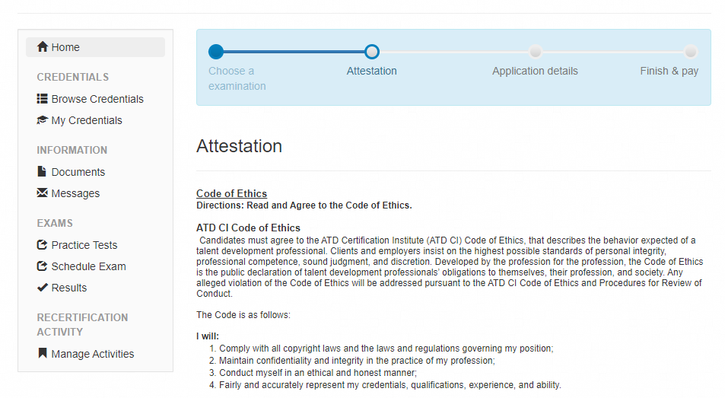
The Application
email@email.com

Slide 21
The Audit process
Approximately 25% of applications are randomly audited.
Why we audit
What to do if audited
Maintain standards for the certification
Submit your documentation supporting your professional development via the secure messaging system in the Certification Portal.
Ask questions via the secure messaging system.
Audited applications deemed ineligible or without proper documentation will receive a refund minus a $250 review fee.
How you know you’ve been audited
People who are selected for audit will receive an email with instructions on how to respond.
It occurs almost immediately.
You have 60 days to respond; the application will be held until the audit is wrapped up.

Slide 22
Locating secure messages
email@email.com

Slide 23
Choosing the right window to test

Slide 24
Let’s look at 2023 test dates
Jan
Feb
Mar
Apr
May
Jun
APTD
CPTD
APTD
CPTD
APTD
CPTD
CONTOSO
A
CONVENIENT
Jul
Aug
Sep
Oct
Nov
Dec
EXPENSIVE
AFFORDABLE
APTD
CPTD
APTD
CPTD
APTD
CPTD
D
C
E
B
Determine readiness based on gap analyses.
Think of time commitments, study group schedules as well as personal and professional time constraints.
The average APTD prep time is 3-6 months and the average CPTD prep time is 6-9 months.
Target the first month you think you will be ready.

Slide 25
Set yourself up for success
2 months
May
Jun
CONTOSO
Jul
CONVENIENT
A
APTD
CPTD
APTD
A candidate testing for the APTD targets May, but has July to fall back on.
EXPENSIVE
AFFORDABLE
2 months
D
Oct
Nov
C
Dec
CPTD
APTD
CPTD
A candidate testing for the CPTD targets October, but has December to fall back on.
E
B
A savvy candidate chooses wisely; transfers to other windows incur transfers fees.

Slide 26
Preparing for the exams

Slide 27
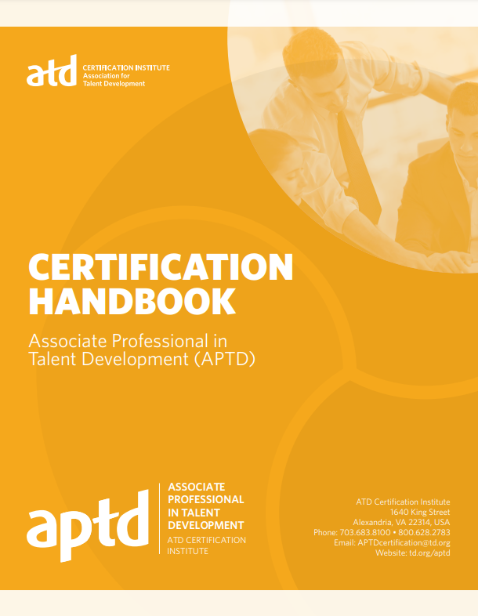
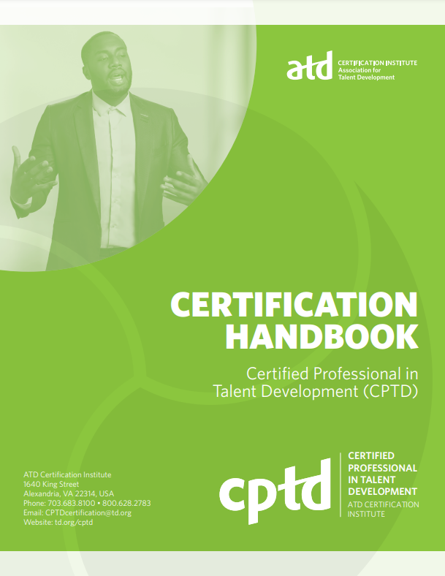
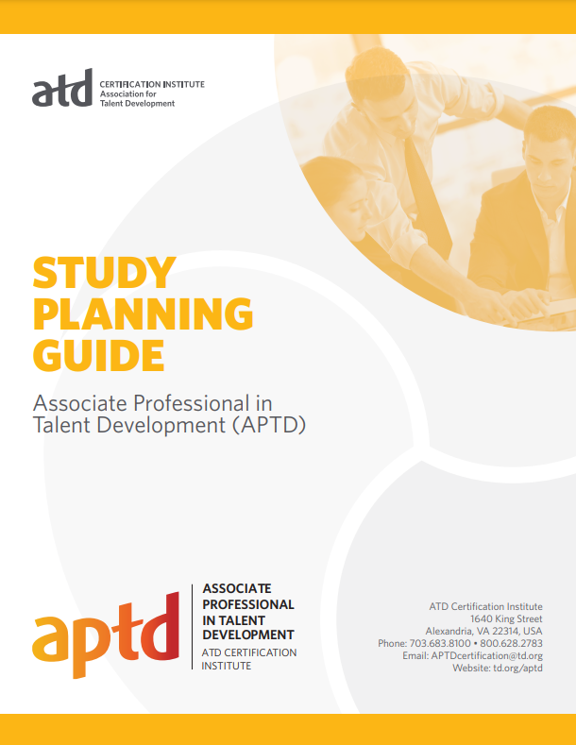
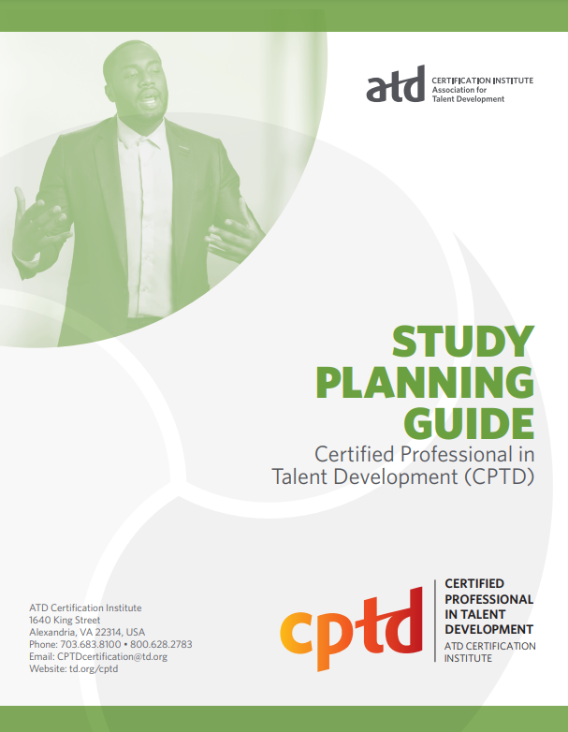
Free resources on the
ATD CI pages
Other Helpful Links
Active Candidates Page
Current Chapter Study Groups
Study Group Guide
APTD & CPTD Certification Handbooks
Policies & Procedures
APTD & CPTD
Study Planning Guides
Gap Analysis, Sample Questions, Reference Reading List, Sample Questions

Slide 28
What are the options to prepare?
OPTION | Cost | Pros | Cons
Self-directed study using Gap Analysis, Content Outline, Reference Reading List, and own study plan | Varies; books can be borrowed from a library | You’re in control; cheapest option | No feedback or cheerleading mechanism
Self-directed study using Gap Analysis, Content Outline, Reference Reading List, and own study plan Add ATD Study Group Participation | Varies, usually around $50 | Access to SMEs; dedicated and organized programming; opportunities to network | May not fit your schedule
Self-directed study using Gap Analysis, Content Outline, Reference Reading List, and own study plan Add Talent Development Body of Knowledge (TDBoK) | Varies; at least $195/$295 | TDBok e-reader provides access to content that explains the what and why; also has ability to bookmark, highlight, and create flashcards | Still lacks feedback mechanism and the “how” of TD
Self-directed study using Gap Analysis, Content Outline, Reference Reading List, and own study plan Add Talent Development Body of Knowledge (TDBoK) Add 3-attempt Practice Test | Varies, at least$195/$295 for TDBok and $95/$145 for Practice Test | Still in control; cheaper than prep course, now with a feedback mechanism | Still lacks the “how” aspect of the concepts

Slide 29
What are the options to prepare?
OPTION | Cost | Pros | Cons
Go through the ATD Preparation Course
APTD Prep Course | $1395/$1695 | Access to SMEs; dedicated and organized programming; opportunities to network | May not fit your schedule
CPTD Prep Course | $1695/$1945 | TDBok e-reader provides access to content that explains the what wand why; also has ability to bookmark, highlight, and create flashars | Still lacks feedback mechanism and the “how” of TD
12-month access to customizable resources including content modules, adaptive self-assessments, facilitated live online sessions, discussion boards, and study support tools including the timed practice test and the TDBoK
Most expensive option of all; self-paced still also means self-motivated.

Slide 30
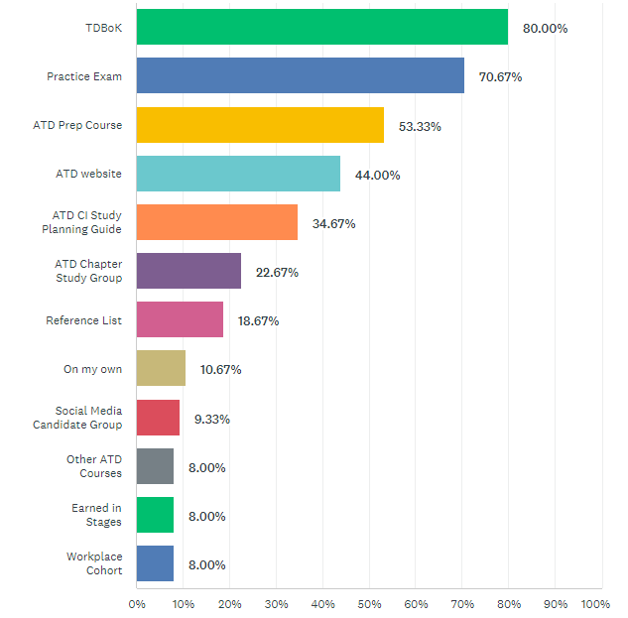
HOW others have prepared
PHASE 1: FEB 20XX
Roll out product to high profile or top-level participants to help establish the product
PHASE 2: MAY 20XX
Release of the product to the general public and monitor press release and social media accounts
PHASE 3: OCT 20XX
Gather feedback and adjust product design as necessary
n=75

Slide 31
How to get support

Slide 32
Build SUPPORT
Self
Supervisor
Family
Colleagues
Get buy-in
Find a mentor
Get financial/time off support
Built in Cheer squad
Stay motivated

Slide 33
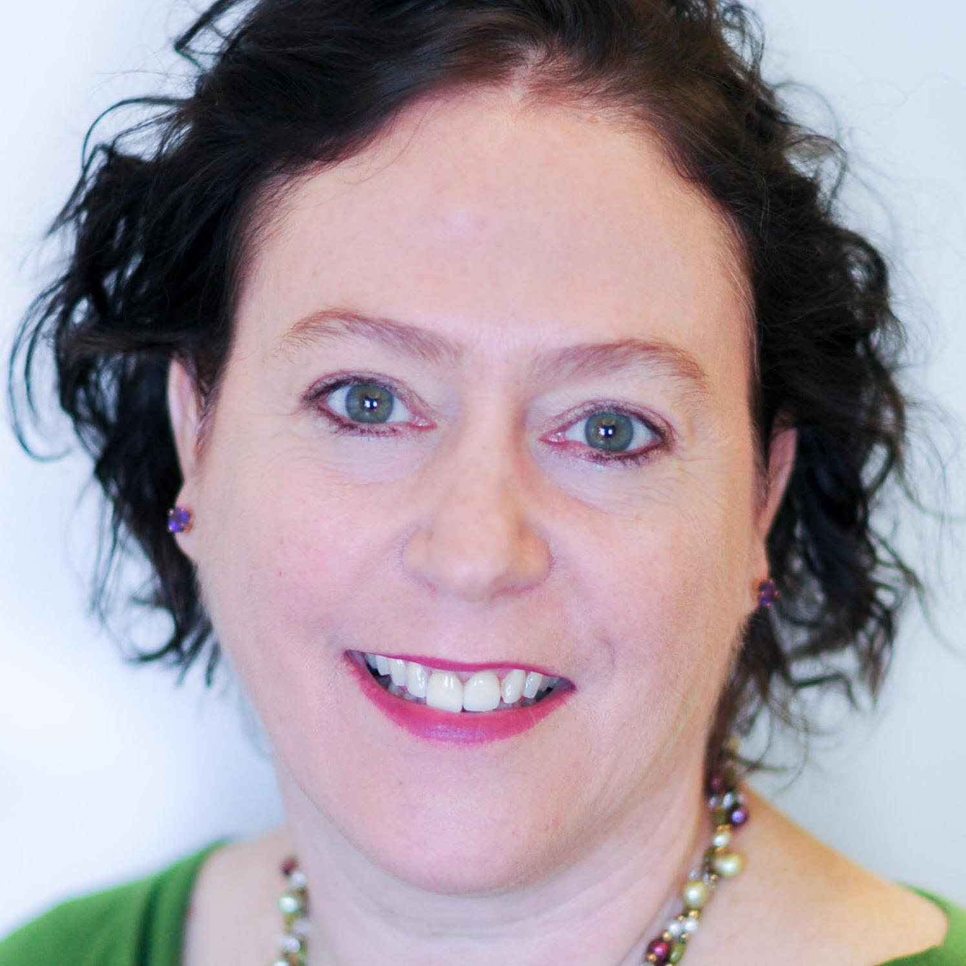
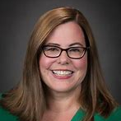
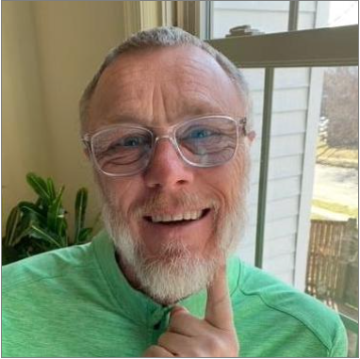
MEET THE TEAM
Morgean Hirt
Holly Batts
John Griffin
Director, Credentialing
Associate Director, Credentialing
Certification Specialist

Slide 34
THANK YOU
For additional information, write to
certification@td.org

