Slide 1
APTD and CPTD Certification Study Hacks
Notes:
Intro Self and Panel
Format Q & A discussion
Use the chat throughout
Kick off with some considerations for preparing to prepare and then open up for you to speak with the panel
They will share their experiences in preparing for the exam AND are here to answer your qs

Slide 2
Notes:
Intro Self and Panel
Format Q & A discussion
Use the chat throughout
Kick off with some considerations for preparing to prepare and then open up for you to speak with the panel
They will share their experiences in preparing for the exam AND are here to answer your qs

Slide 3
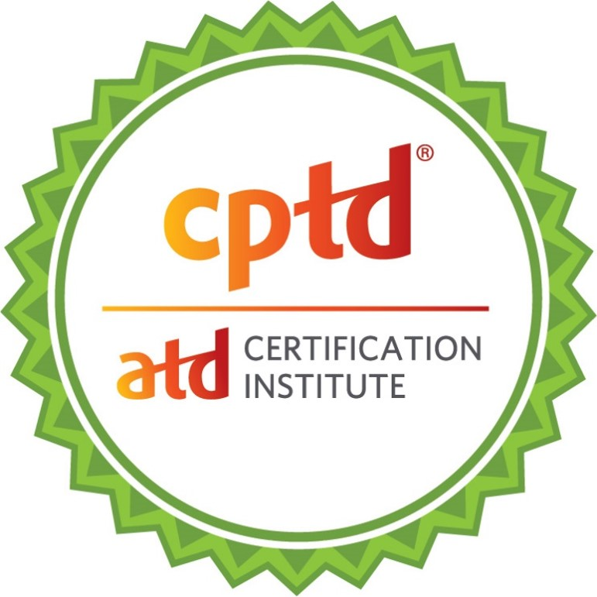
Which Certification are you pursuing?
APTD
Associate Professional in Talent Development
CPTD
Certified Professional in Talent Development
Undecided

Slide 4
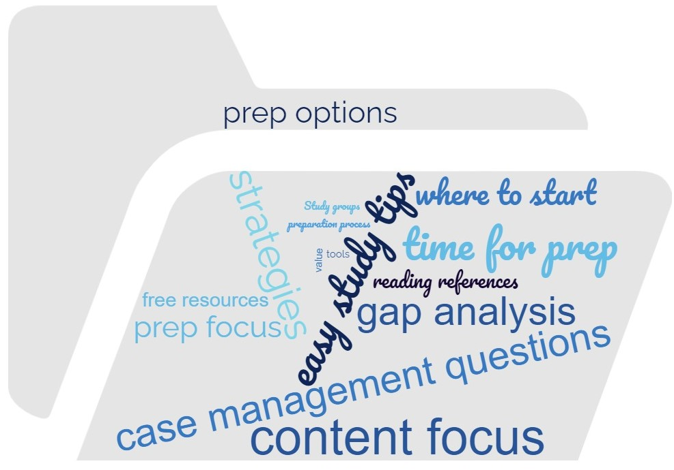
What do you want to hear about today?

Slide 5
Get Prepped to Prep
Consider the following:
Where to begin
How to get organized your way
Available resources (Meet your APTDs/CPTDs!)

Slide 6
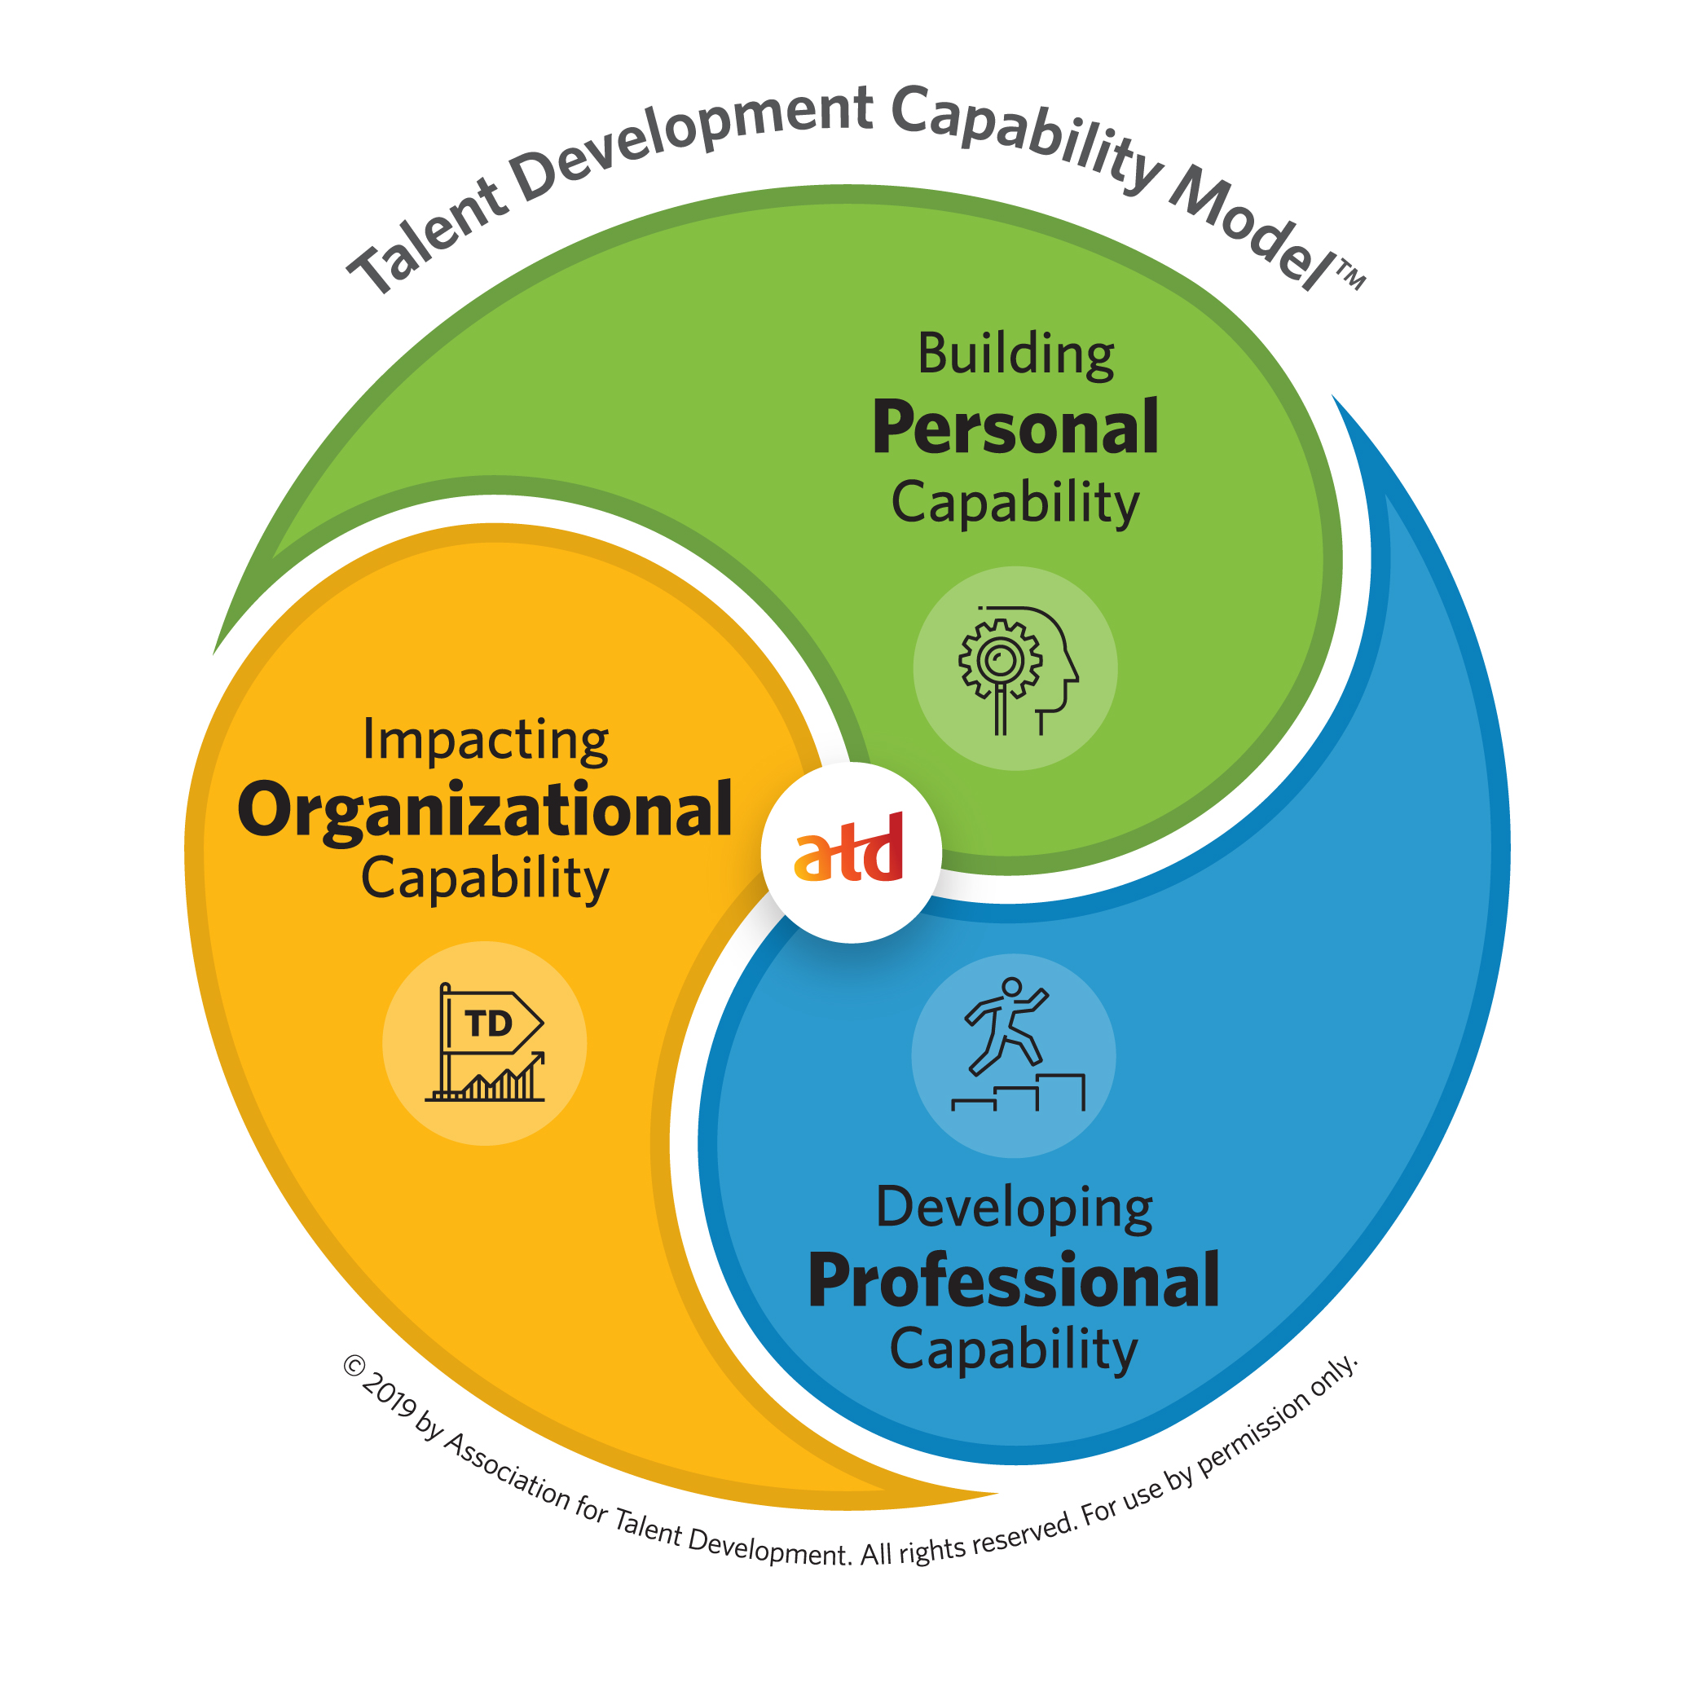
The Capability Model
3 Domains of Practice
Personal, Professional, Organizational
23 Capabilities
Knowledge and Skills
capability.td.org
Notes:
First the scope, of your practice
The TDCM -scope of practice w/i TD. It’s everything you need to know and do to be successful.
There are 3 domains of practice- Personal, Professional, and Organizational capability.
Within each of the 3 domains of practice, there are 23 capabilities
The capabilities are further defined by K&S statements
APTD/CPTD exams test a subset of these K&S which are organized in the ECO Outlines

Slide 7
Three Steps to Prep
STEP 1: Assess Your Knowledge & Gaps
STEP 2: Create a Study Plan
STEP 3: Choose Your Resources

Slide 8
STEP 1: Assess Your Knowledge…Gaps
Take the online Self-Assessment at capability.td.org
Rate your experience level within the KSAs
Choose the APTD- or CPTD-Ready Learning Path
View My Report (Proficiency)
Explore recommended resources
Notes:
Step 1: Assess Your Knowledge Level. What do you need to know/ what is on the exam?! From there you can id how to fill in any K gaps, focus your efforts.
Start with the online self-assessment as part of the Talent Development Capability Model.
This is a 45-minute online endeavor where you will rate your proficiency in the knowledge areas of the 23 capabilities within the model. At completion, you can select an “APTD- or CPTD-Ready" learning path option. This will provide a customized gap analysis by comparing your scores with the recommended proficiency level for ONLY those knowledge and skill statements covered on the APTD/CPTD exam. This will help you identify where you need to spend more prep time.

Slide 9
STEP 2: Create a Study Plan
Target testing window
Average of 6 months
60 – 80 hours (APTD)
80 – 100 hours (CPTD)
Week-by-week planning
Block your calendar
Notes:
Step 2: Make a Study Plan Step 2 – When you know the scope of content, you can then build out a study plan
To create a timeline of study, start with your target exam date. How much time will you need to get there?
When do you plan to test?
Consider work and personal life demands for the next 3, 6, 8 months; AVG prep- 60-100, 3-6 mos
Break out your plan by week- Focus on gaps, consider your schedule, and your learning prefs- do you work better independently, study group? How do you hold yourself accountable?
Then Block your calendar!- If you can have the support of your employer or colleagues-great! Setting aside a regular period of time to prepare weekly can help you keep to your plan.

Slide 10
STEP 3: Choose Your Resources
Visit the APTD or CPTD Prepare webpage
APTD/CPTD Study Planning Guide
Learning Path Recommendations (from the self-assessment)
TD Body of Knowledge (TDBoK) Guide
Notes:
Step 3: Know your Resources- In the third step, its time to collect the resources and tools to get started
Candidates use a variety of resources to prepare depending upon the way they study best.
Web pages!
It is recommended to start with the Study Planning Guide- This free guide incl everything from the ECO, to a sample 12-week study plan organized by capability area, sample questions, test taking strategies, and a reading reference list organized by capability area.
Resources: After you’ve taken the self-assessment, consider the Learning Path recommendations- and select resources specific to filling your knowledge gaps; the Study Guide has a general list org’d by capability area. The TDBokGuide
The TDBoK Guide- is THE comprehensive resource for TD professionals. It is a collection of concepts, definitions, methodologies, and examples of content from the Capability Model. It is INCLUDED with and ATD mbrshp or a Prep Course. It is a great framework for organizing your prep and filling in K gap areas

Slide 11
STEP 3: Choose Your Resources Adventure
Join a Chapter Study Group (Chapter locator)
Register for the APTD/CPTD Preparation Course
Utilize the full length APTD/CPTD Practice Test
Join live discussions with APTDs and CPTDs; staff
Share on the LinkedIn APTD or CPTD Candidate Prep
Notes:
Step 3: Know your Resources- Resources such as study tools or people include
Many chapters offer certification study groups twice a year which are virtual or in person. Dedicated webpage for current offerings
Consider taking an on-demand APTD or CPTD Prep Course.
The Full-length Practice Test is administered using the same system that you will use to take your certification exam. It includes the same number and type of questions you will see on the exam and it is a fully timed. It can be accessed three times. Summarized and item-level feedback is provided.
ATD CI hosts monthly Q&As with panels of APTDs and CPTDs to discuss preparation strategies. Staff office hours are another opp to get your process or tech related qs answered.
LinkedIn- place to share prep tools and tips…flashcards, You tube links and other used generated tools.

Slide 12
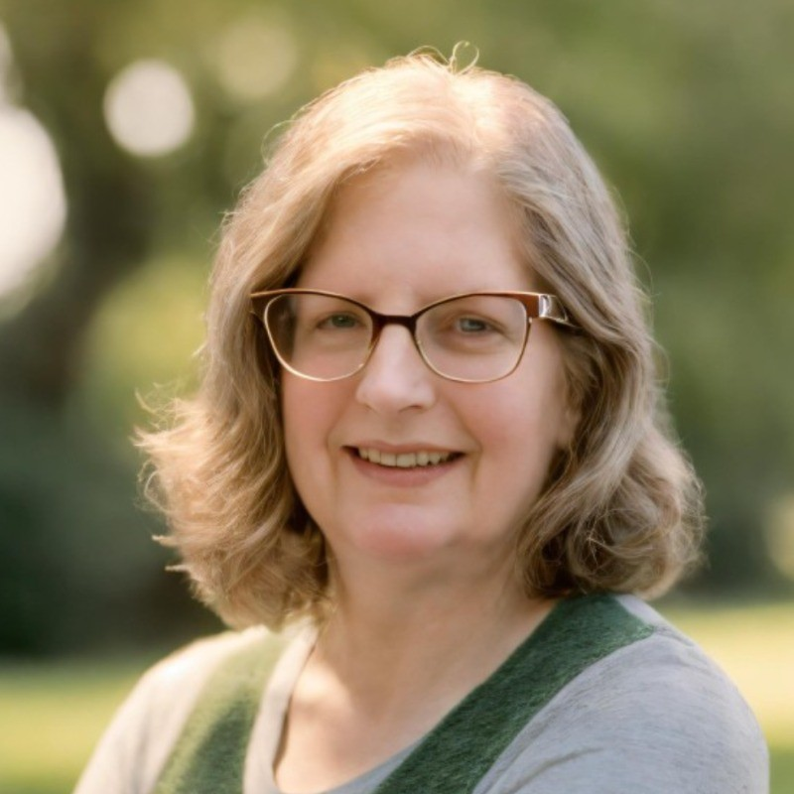
Today’s Panelists
Your Panelists
Jill Kasten, CPTD
Training Specialist
Wind River Environmental Services
Elijah Merrett, APTD
Sales Enablement Specialist
Bloomerang
Adam White, CPTD
Organizational Development Consultant
Penn State Health

Slide 13
More Information
Visit Us: www.td.org/certification
Contact Us: certification@td.org
Join Us:
Zoom Office Hour with ATD CI Staff
Zoom Q&A with APTDs & CPTDs

Slide 14
Trust Your Prep on Exam Day!

